Slide 1
Car Price Prediction Project
Aaron Dsouza

Slide 2
Agenda / Topics
Problem Definition
Data Analysis
EDA (Exploratory Data Analysis)
Pre-processing Pipeline
Building Machine Learning Models
Concluding Remarks

Slide 3
Problem Definition
A car price prediction has been a high interest research area, as it requires noticeable effort and knowledge of the field expert.
Accurate car price prediction involves expert knowledge, because price usually depends on many distinctive features and factors.
With the COVID 19 impact in the market, we have seen lot of changes in the car market. Now some cars are in demand hence making them costly and some are not in demand hence cheaper.
One of our clients works with small traders, who sell used cars. With the change in market due to COVID 19 impact, our client is facing problems with their previous car price valuation machine learning models. So, they are looking for new machine learning models from new data. We have to make car price valuation model.

Slide 4
Data Analysis
As an aspiring Data Scientist, the goal is to create a model that will predict the used car prices with the available independent variables.
This model will then be used by the management to understand how exactly the prices vary with the variables.
The company can accordingly manipulate the strategy of the firm and concentrate on areas that will yield high returns.
Further, the model will be a good way for the management to understand the pricing dynamics of a new market.

Slide 5
Data Analysis
The sample data was scrapped from Cars24.com by using selenium web-driver in python programming language.
A total of three data types in the data set Int and Object.
The data collected was saved in .CSV (comma-separated values) format.
The data set has a total of 10 columns

Slide 6
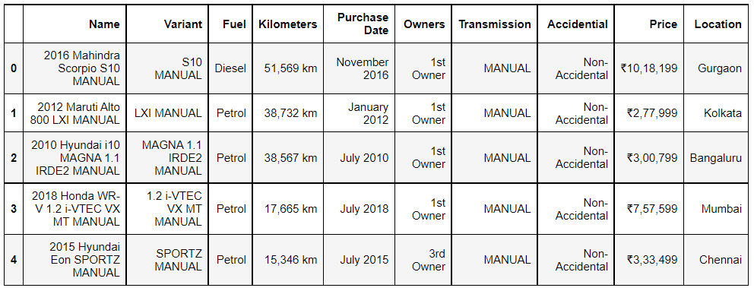
Data Analysis
Dataframe Sample

Slide 7
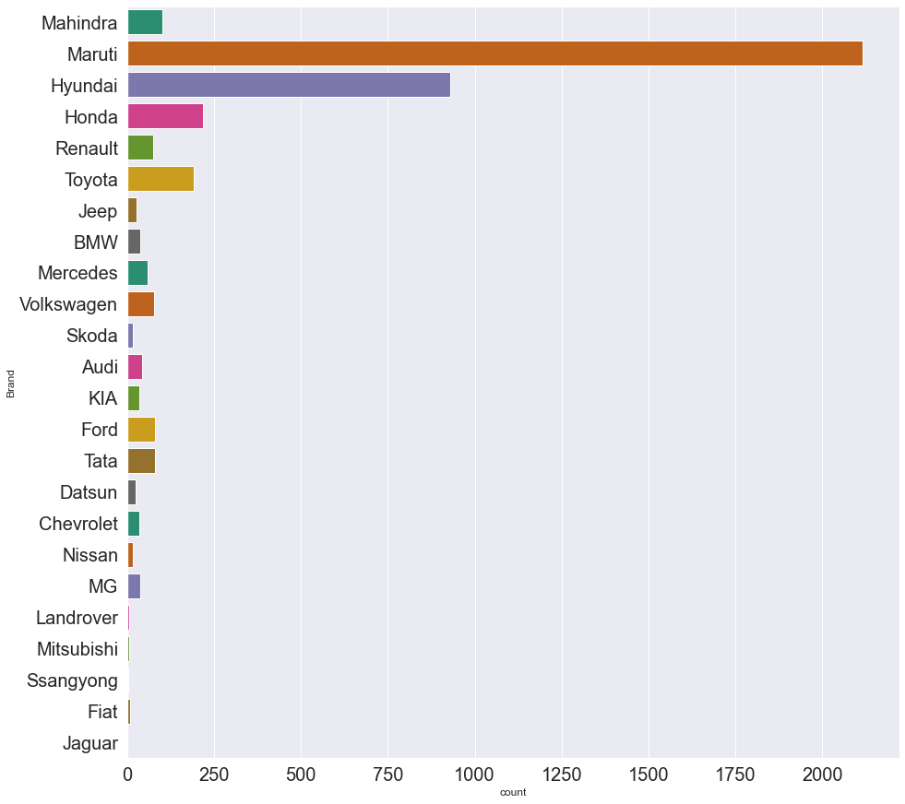
EDA (Exploratory Data Analysis)
From the above plot, we can conclude that Maruti is the most trusted brand for buying cars in India.

Slide 8
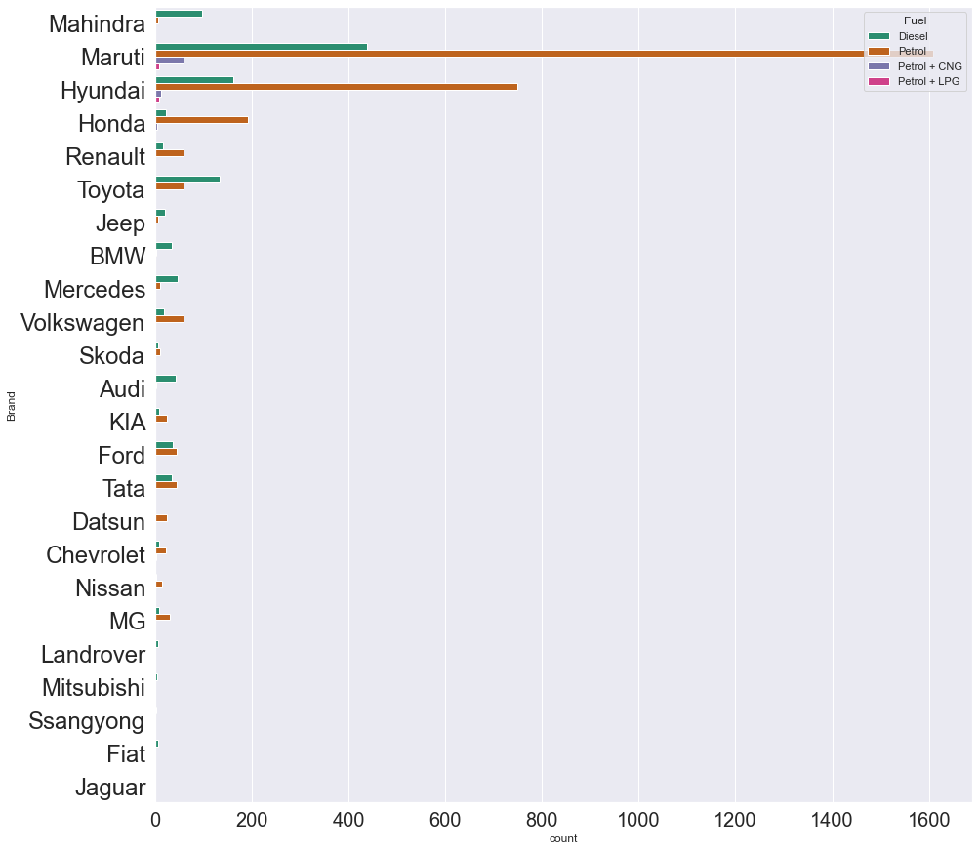
EDA (Exploratory Data Analysis)
Most of the used cars which are for sale have fuel type Petrol. There are some rare cars with fuel type Petrol + CNG or Petrol + LPG. Maybe customers in India mostly prefer to buy petrol variant cars.

Slide 9
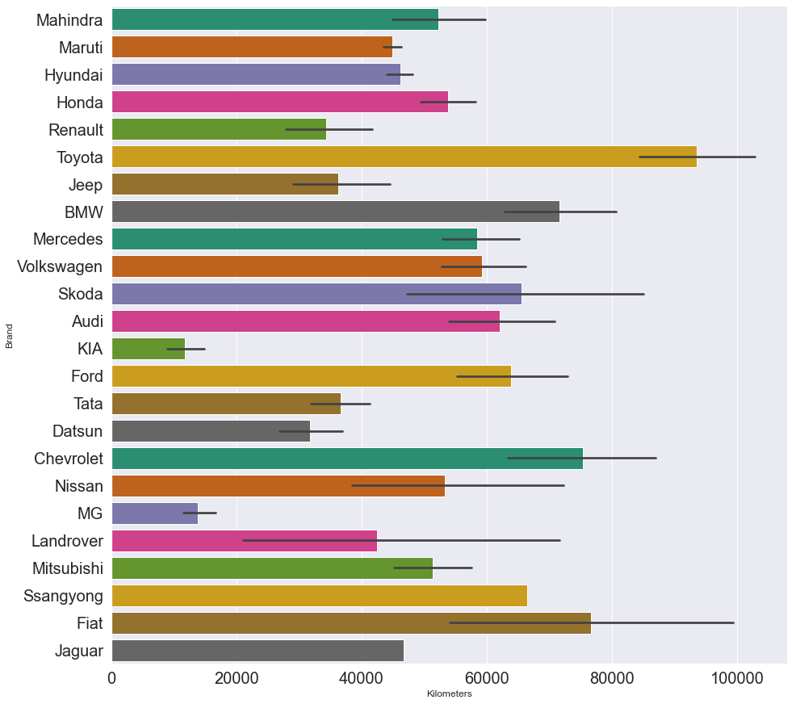
EDA (Exploratory Data Analysis)
Car brands Toyota, Chevrolet, BMW and Fiat have the highest running kilometres of approximately more that 70,000 km. MG and Kia have the lowest running kilometres less than 20,000 km

Slide 10
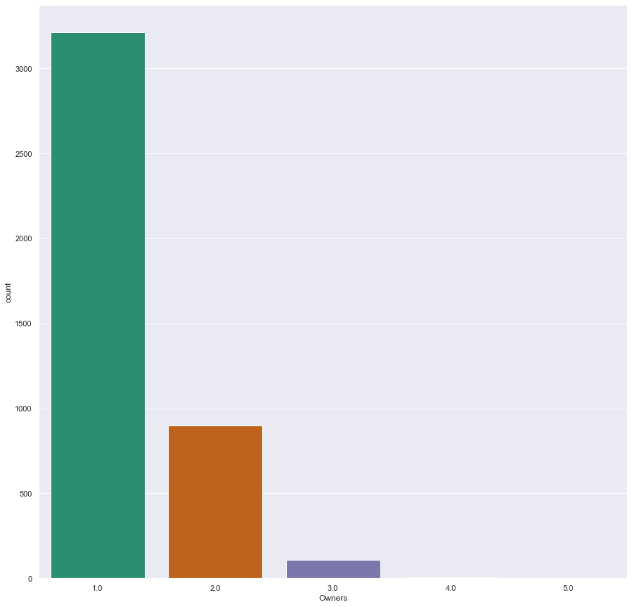
EDA (Exploratory Data Analysis)
From the plot above we can clearly say that, most of the used cars are single owner cars.

Slide 11
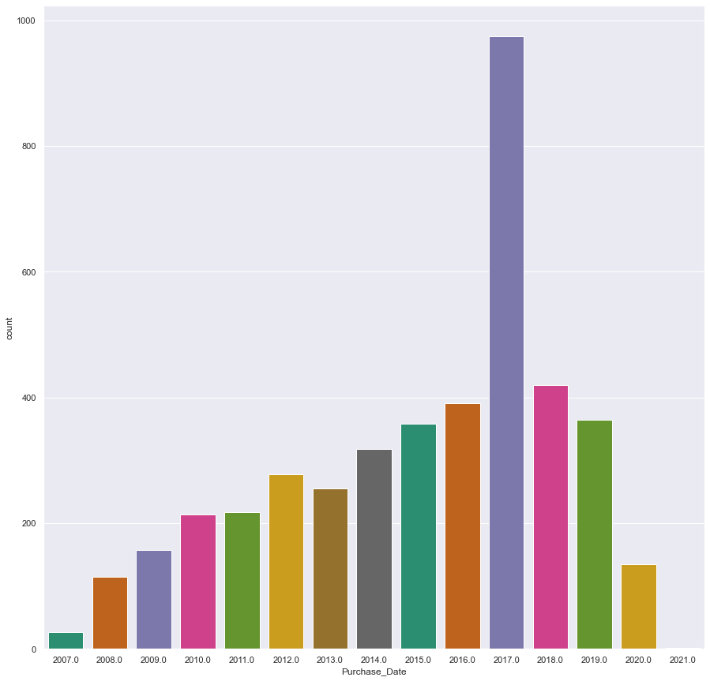
EDA (Exploratory Data Analysis)
Most of the cars were purchased in the year 2017

Slide 12
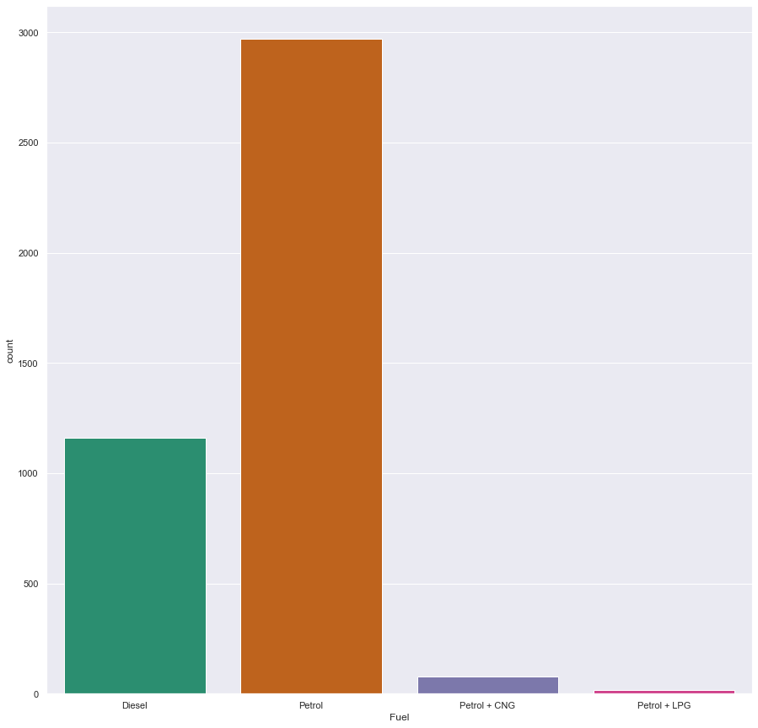
EDA (Exploratory Data Analysis)
From the above plot we can conclude that, most of the used cars are petrol variant.

Slide 13
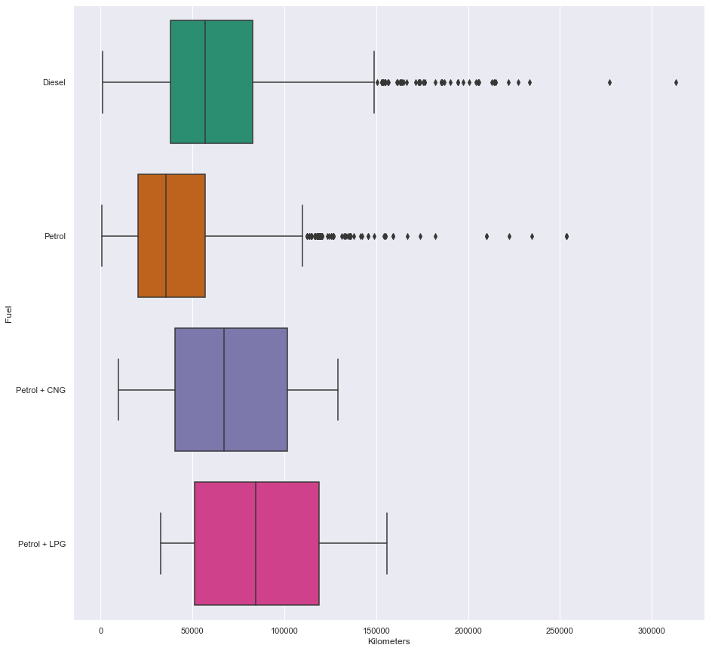
EDA (Exploratory Data Analysis)
Cars running on fuel type petrol have fewer running kilometres as compared to other fuel types. Fuel type Petrol + LPG have the highest running kilometres more than 80,000 km.

Slide 14
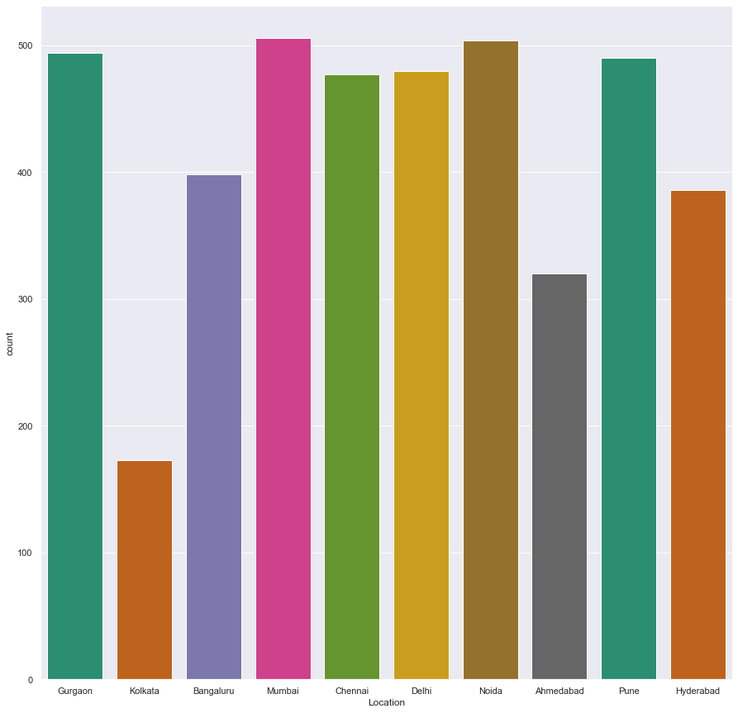
EDA (Exploratory Data Analysis)
Mumbai has the highest number of used cars recorded in this dataset. Kolkata has the lowest number of used cars.

Slide 15
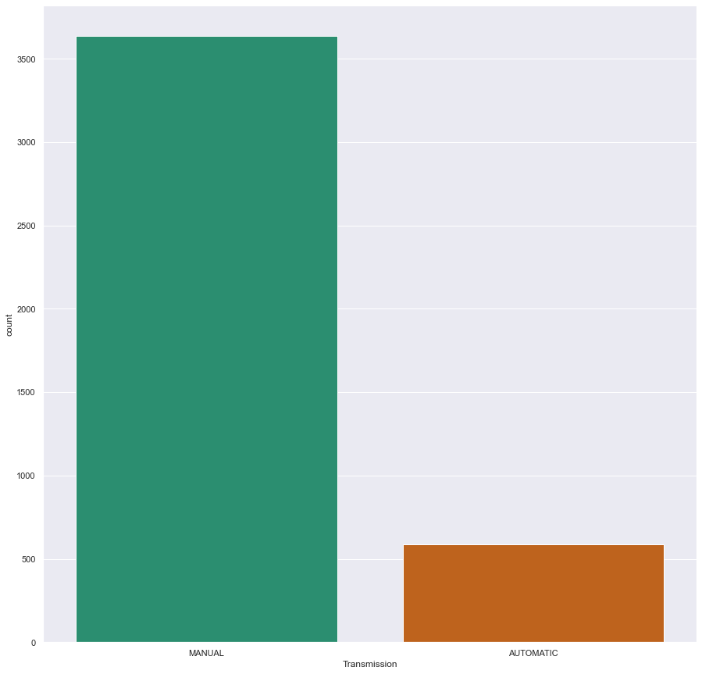
EDA (Exploratory Data Analysis)
Most of the customers prefer Manual transmission cars.

Slide 16
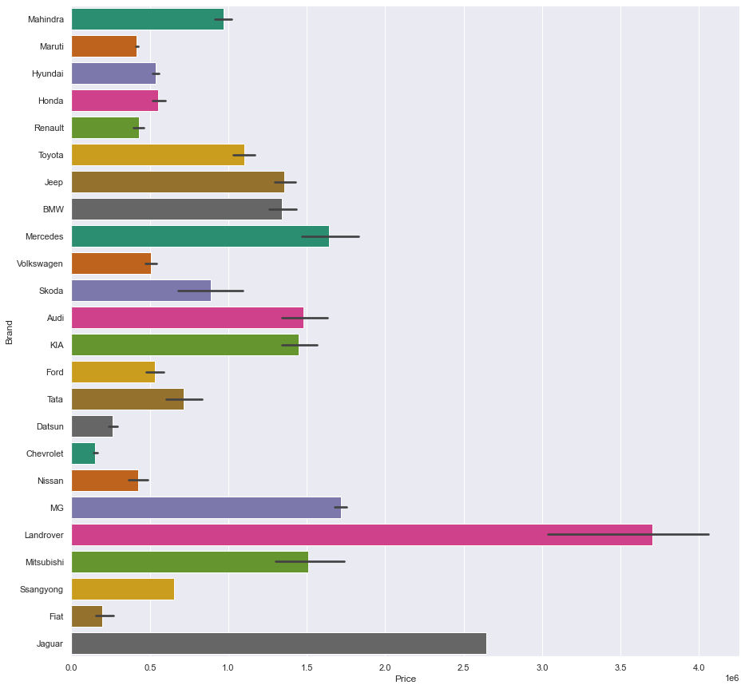
EDA (Exploratory Data Analysis)
We can clearly observe that Luxury brands like Land-rover, Jaguar, and Mercedes are quite expensive. But there are also a lot of cars available for average customers.

Slide 17
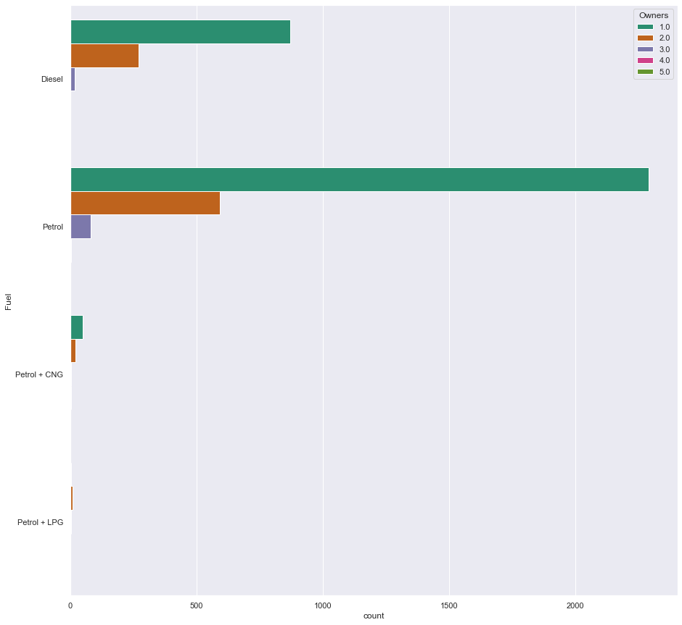
EDA (Exploratory Data Analysis)
Most of the cars with only one previous owner, are petrol variant cars.

Slide 18
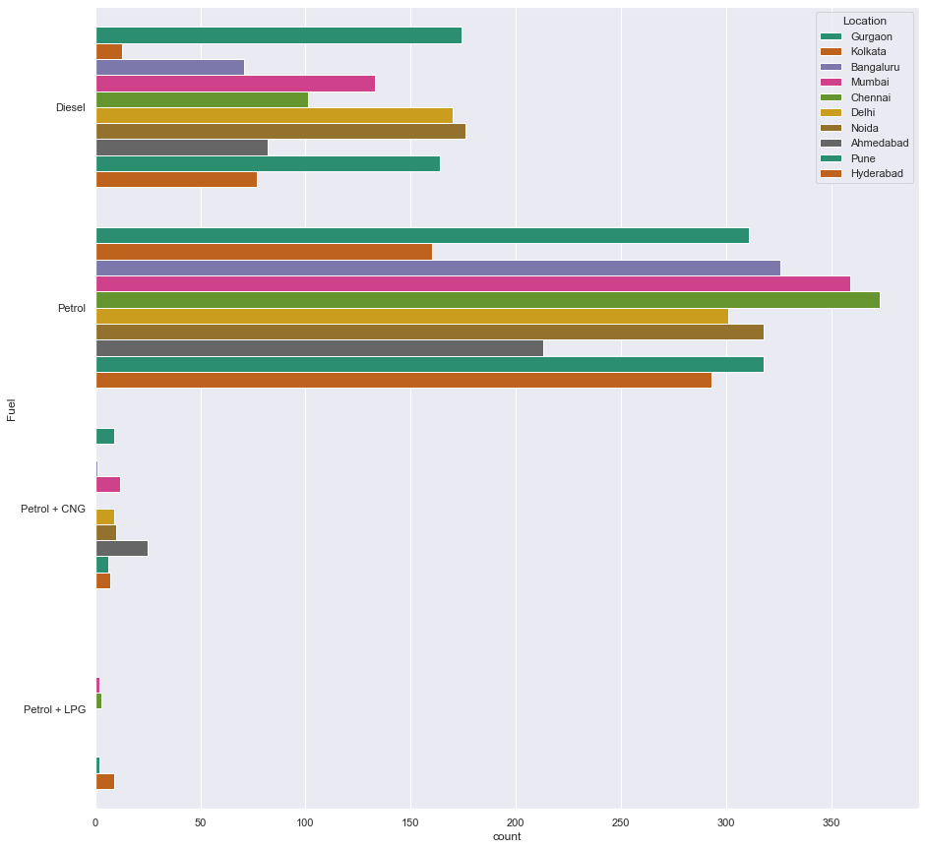
EDA (Exploratory Data Analysis)
Most of the cars with only one previous owner, are petrol variant cars.

Slide 19
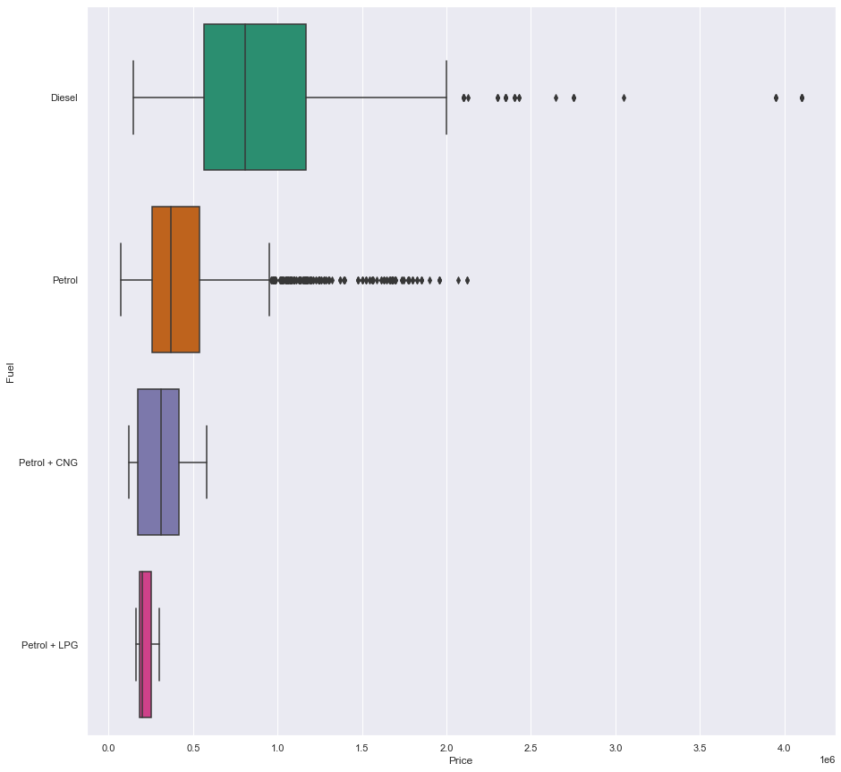
EDA (Exploratory Data Analysis)
Diesel cars are more expensive than any other fuel type including petrol, LPG and CNG.

Slide 20
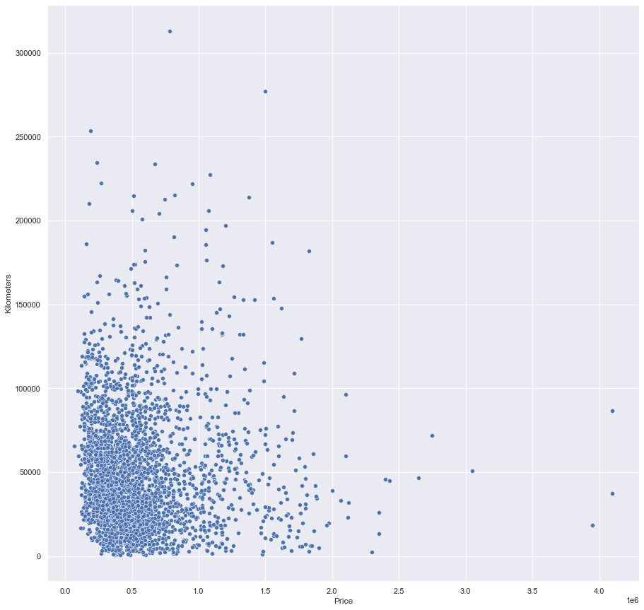
EDA (Exploratory Data Analysis)
From the above plot we can say that some of the used cars with less kilometres will be more expensive.

Slide 21
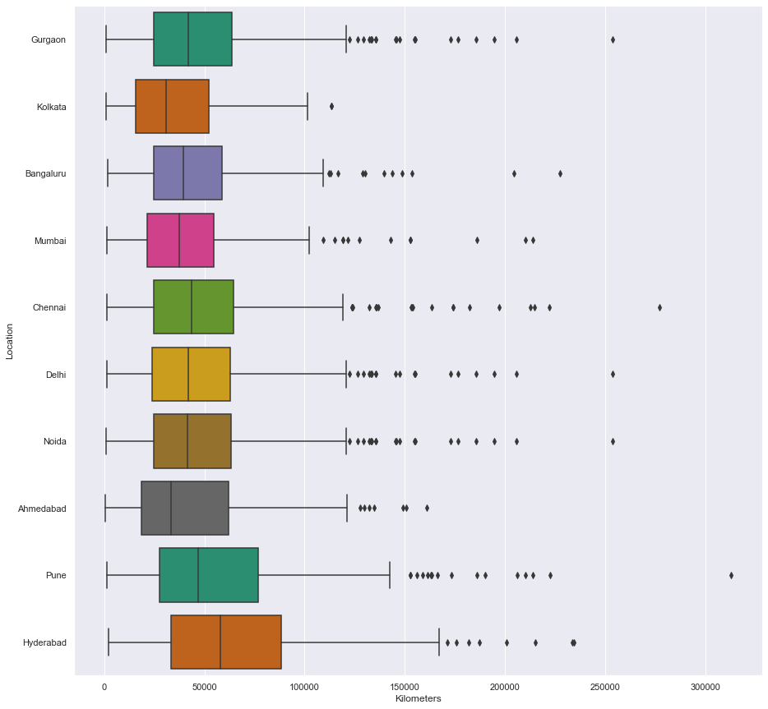
EDA (Exploratory Data Analysis)
Used cars from location Hyderabad have the highest running kilometres of more than 65,000 km

Slide 22
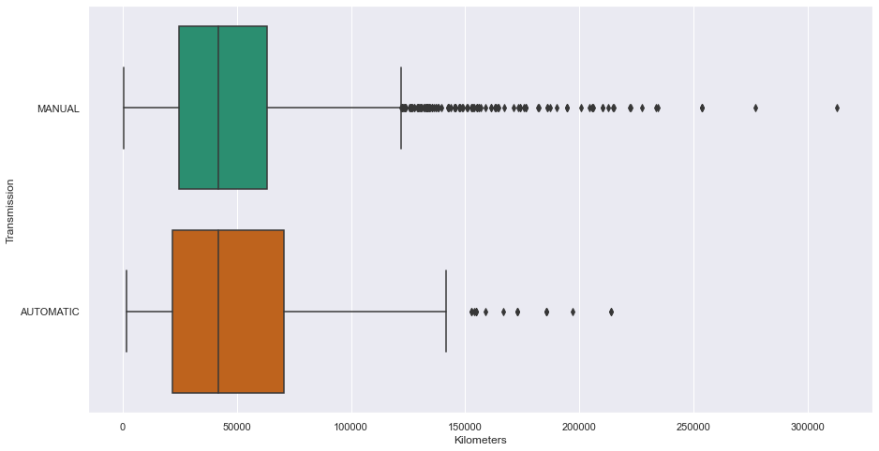
EDA (Exploratory Data Analysis)
Used Cars with transmission type Automatic have higher running kilometres as compared to transmission type Manual

Slide 23
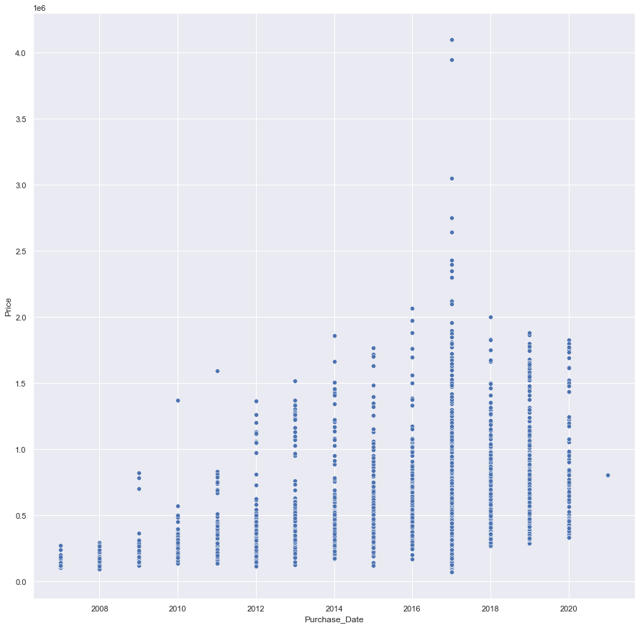
EDA (Exploratory Data Analysis)
We can clearly observe that, the newer the used car is the more expensive it will be.

Slide 24
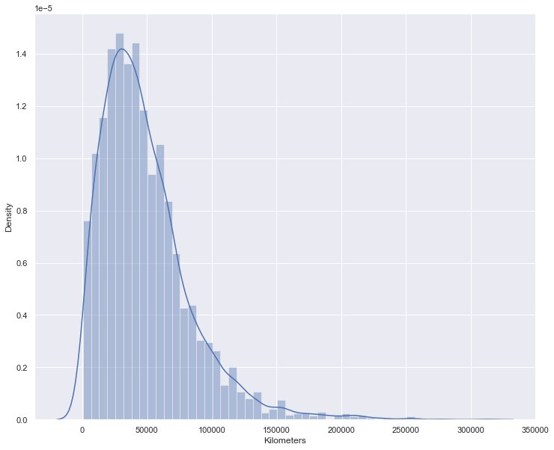
EDA (Exploratory Data Analysis)
Average running kilometres per car is ~ 48,688. Lowest running km for a car is about 648 km

Slide 25
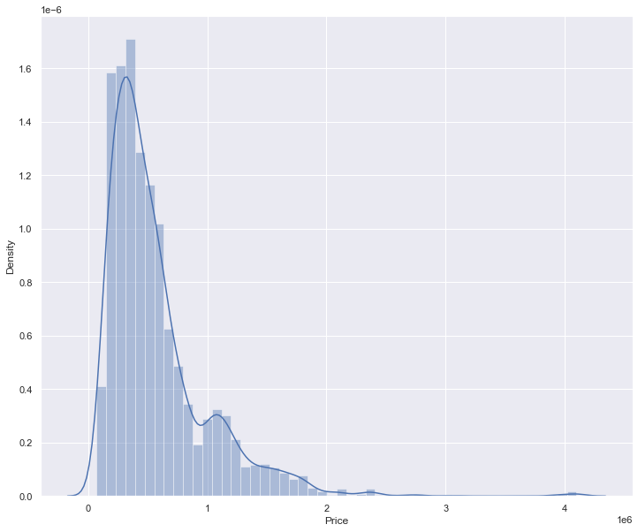
EDA (Exploratory Data Analysis)
Average price for used cars is about Rs ~ 5,72,921. The price variable looks normally distributed.

Slide 26

Pre-processing Pipeline
Step – 1
We can drop the Accidental column as it only has one value and it will not have any significant affect on the target variable.

Slide 27
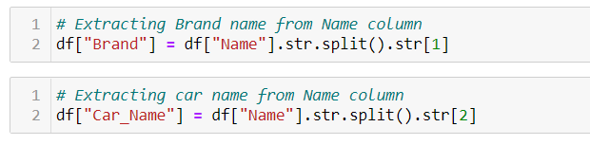
Pre-processing Pipeline
Step – 2
We create two new columns Brand and Car_name from Name column.

Slide 28

Pre-processing Pipeline
Step – 3
We can drop the name column now as we have already created two new columns from it.

Slide 29

Pre-processing Pipeline
Step – 4
Now we need to extract Transmission type(Manual or Automatic ) from Variant column to create a new column name Transmission

Slide 30

Pre-processing Pipeline
Step – 5
We need to remove the string km from Kilometres column as we only need the numerical data.

Slide 31

Pre-processing Pipeline
Step – 6
We can remove the month name and only keep the year data.

Slide 32

Pre-processing Pipeline
Step – 7
Removing the owner text from owner column as we only need the numerical data (1, 2 or more)

Slide 33

Pre-processing Pipeline
Step – 8
We need to remove the rupee symbol from the Price column.

Slide 34
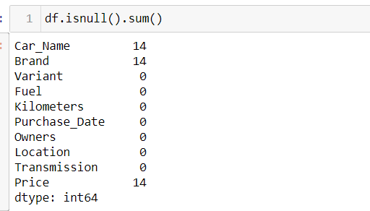
Pre-processing Pipeline
Step – 9
Checking for null values We can drop the null values as there are only 14 null values, so it won’t have a significant effect on the target variable.

Slide 35
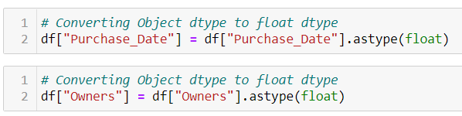
Pre-processing Pipeline
Step – 10
All the data-types are Objects so we need to convert (Kilometres, Purchase_date, Owners and Price to Float)

Slide 36
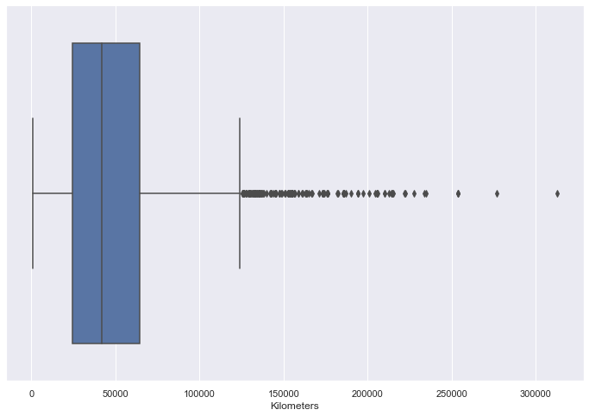
Pre-processing Pipeline
Step – 11
We need to handle outliers and transformations. Fortunately Except Kilometres we don’t have to worry about other independent variables as they are categorical in nature. Using box-plot to visually detect outliers.

Slide 37
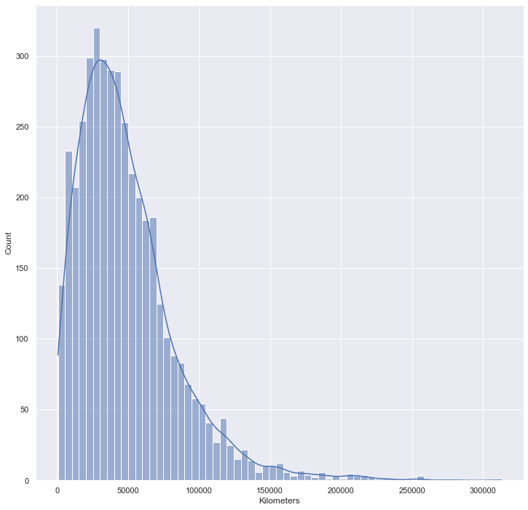
Pre-processing Pipeline
Step – 12
Using hist-plot to understand the distribution of the variable, The distribution for Kilometres seems to be right-skewed

Slide 38
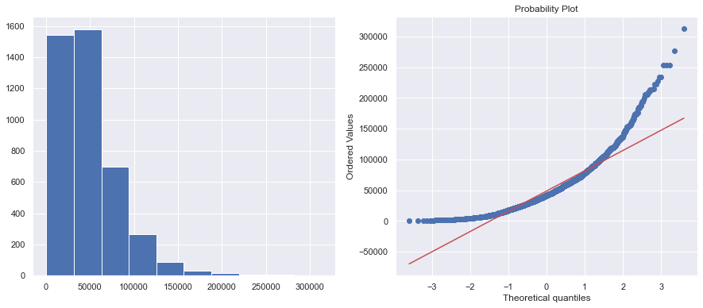
Pre-processing Pipeline
Step – 13
Checking the distribution using Q-Q plot, we can clearly see that the distribution is right-skewed so we need to reduce the skewness and try to make the plot normally distributed.

Slide 39
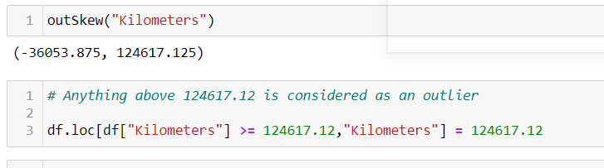
Pre-processing Pipeline
Step - 14
Checking Outliers and replacing them.

Slide 40
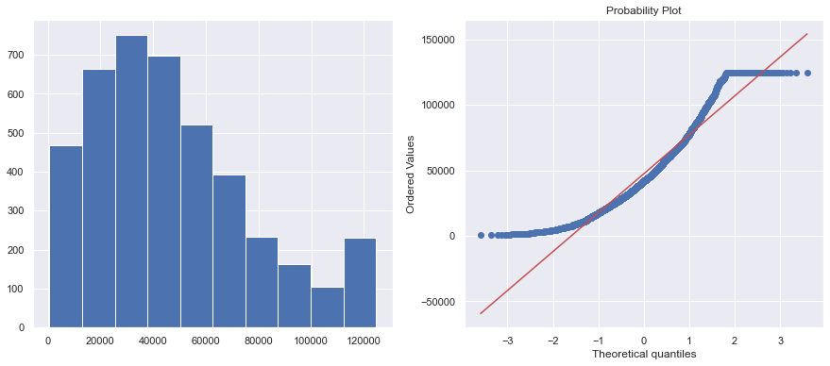
Pre-processing Pipeline
Step – 15
Checking the Q-Q plot after outlier removal. We can clearly observe that the plots looks more like normally distributed and the skewness has been reduced significantly.

Slide 41
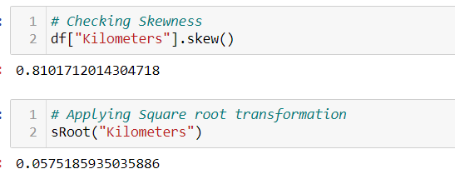
Pre-processing Pipeline
Step – 16
Trying to further reduce the skewness using Square root transformations

Slide 42
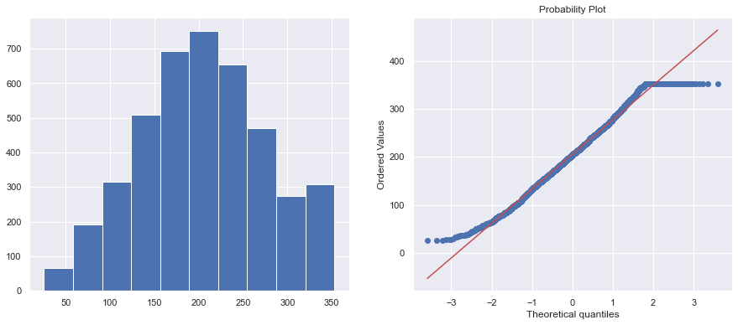
Pre-processing Pipeline
Step – 17
After using square root transformation let’s check the Q-Q plot.

Slide 43
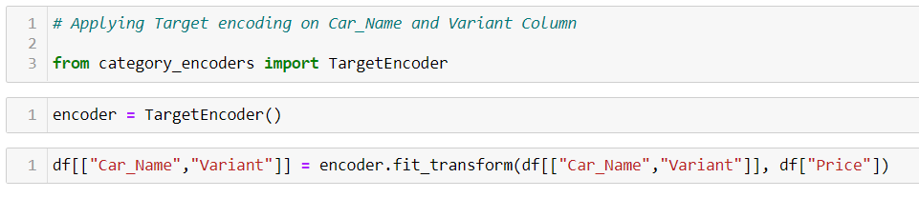
Pre-processing Pipeline
Step – 18
We need to encode the categorical data.
Using Target encoding on Car_name and Variant columns.

Slide 44
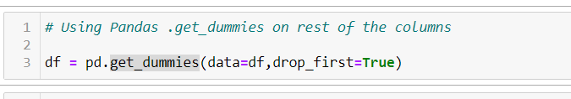
Pre-processing Pipeline
Step – 19
Using pandas get_dummies method on rest of the categorical columns.

Slide 45
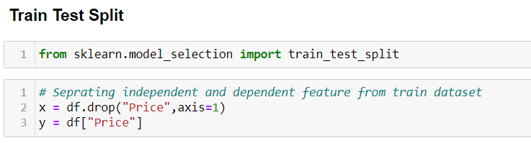
Pre-processing Pipeline
Step – 20
Using Train Test Split on Data-frame

Slide 46
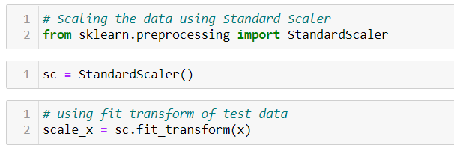
Pre-processing Pipeline
Step – 21
Scaling the data using StandardScalar() method

Slide 47
Building Machine Learning Models
A total of 8 regression models were used in order to predict the target variable Price.
Linear Regression.
Random Forest Regression.
Bagging Regressor.
XGB Regressor.
ADA Boost Regressor.
Regularization(Lasso).
Regularization(Ridge)
Gradient Boosting Regressor.

Slide 48
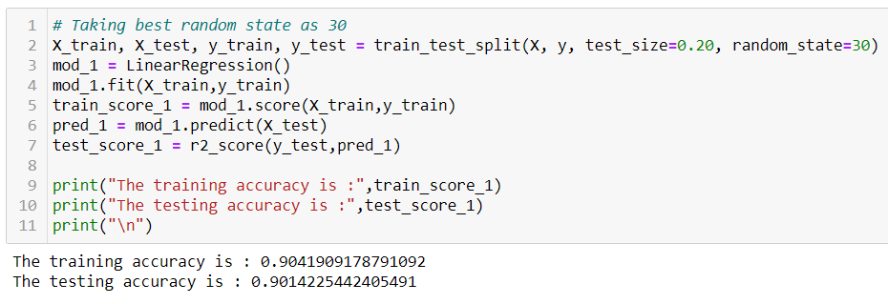
Building Machine Learning Models
Linear Regression

Slide 49
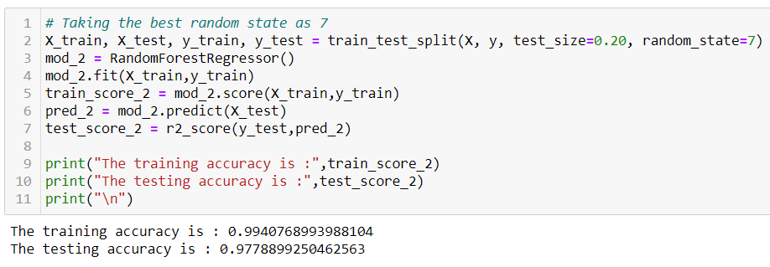
Building Machine Learning Models
Random Forest Regression

Slide 50
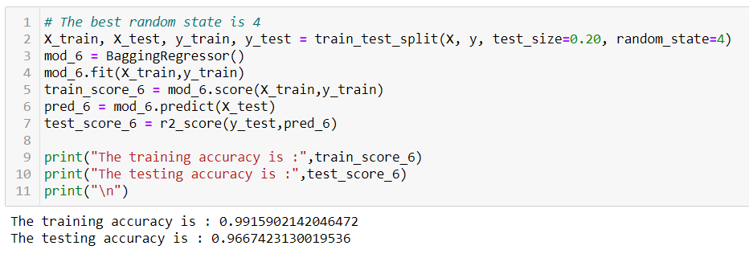
Building Machine Learning Models
Bagging Regressor

Slide 51
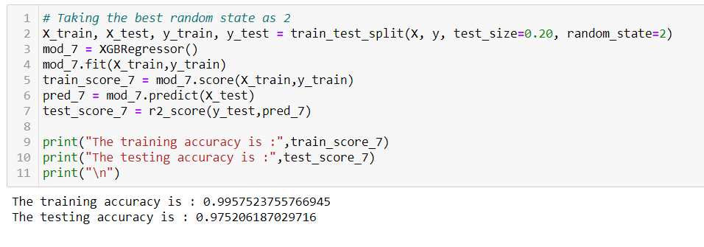
Building Machine Learning Models
XGB Regressor

Slide 52
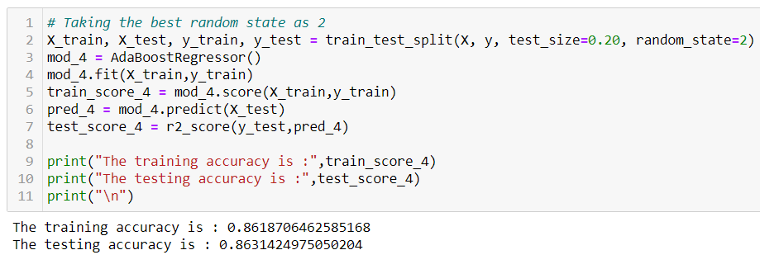
Building Machine Learning Models
ADA Boost Regressor

Slide 53
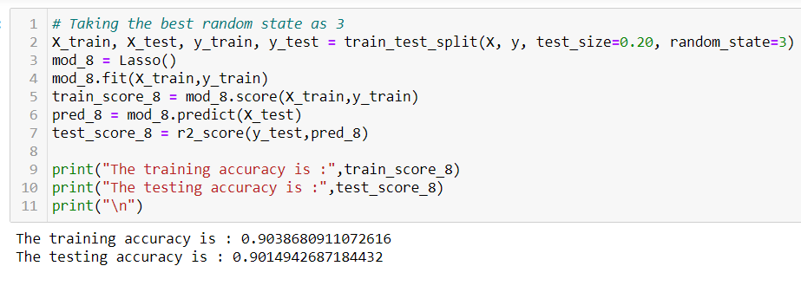
Building Machine Learning Models
Regularization (Lasso)

Slide 54
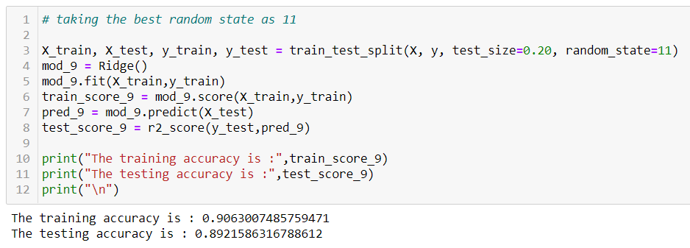
Building Machine Learning Models
Regularization (Ridge)

Slide 55
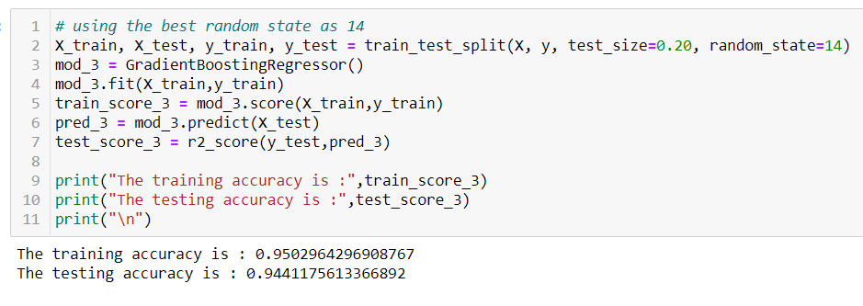
Building Machine Learning Models
Gradient Boosting Regressor

Slide 56
Building Machine Learning Models
Hyper parametric Tuning
Gradient Boosting Regression(Hyper parametric Tuning)
After applying Hyper parametric Tuning for Gradient Boosting regression we get the following results:

Slide 57
Concluding Remarks
In this project, eight different machine learning techniques have been used to forecast the price of used cars in Indian market. The first step I took, was to visualize the distribution of each feature and its effect on the Price (dependent variable). From the analysis, I conclude that some of the most useful features for predictions were "Car Name”, “Variant”, “Purchase Year”, “Kilometers”. The Gradient Boosting Regression Algorithm proved to be the best model for regression based on the Cross-Validation scores. An accuracy (r2 score) of 0.96 % was achieved by hyper parametric tuning of the model.

Slide 58
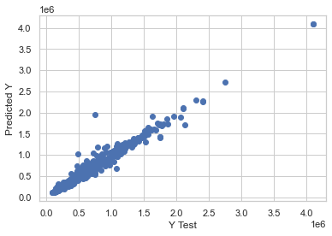
Concluding Remarks Actual values vs Predicted values

Slide 59
Concluding Remarks
The main limitation of this study is the low number of records that have been used. As future work, we intend to collect more data and to use more advanced techniques like artificial neural networks, fuzzy logic and genetic algorithms to predict car prices.

